Slide 1

Biochem 3BP3
Practical Bioinformatics in the Genomics Era
Fall 2021

Slide 2
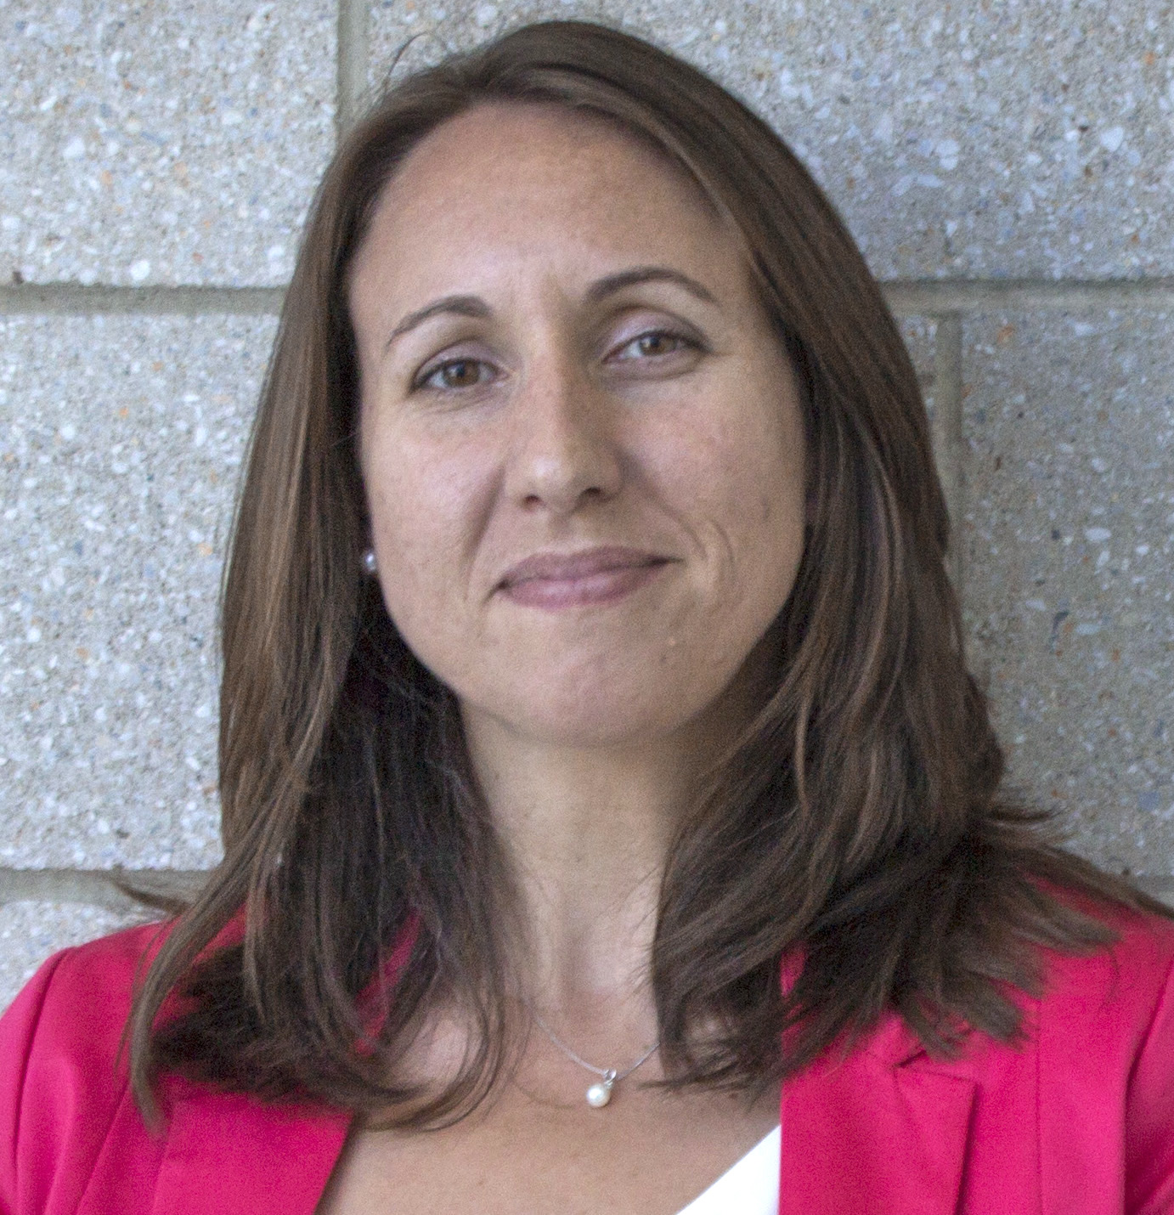
Instructor:
Dr. Jennifer Stearns
BSc in Biology, University of Waterloo
PhD in Biology – Plant-microbe interactions (UW)
short Post-Doc at UW working on the human microbiome and new methods for Illumina sequencing of 16S (Neufeld lab)
full Post-Doc at McMaster University working on the human airway microbiome (Surette lab)
Assistant professor in Medicine at McMaster University
Farncombe Chair in Microbial Ecology and Bioinformatics
Study microbial community succession in the human gut and bacterial interactions in the infant gut microbiota

Slide 3
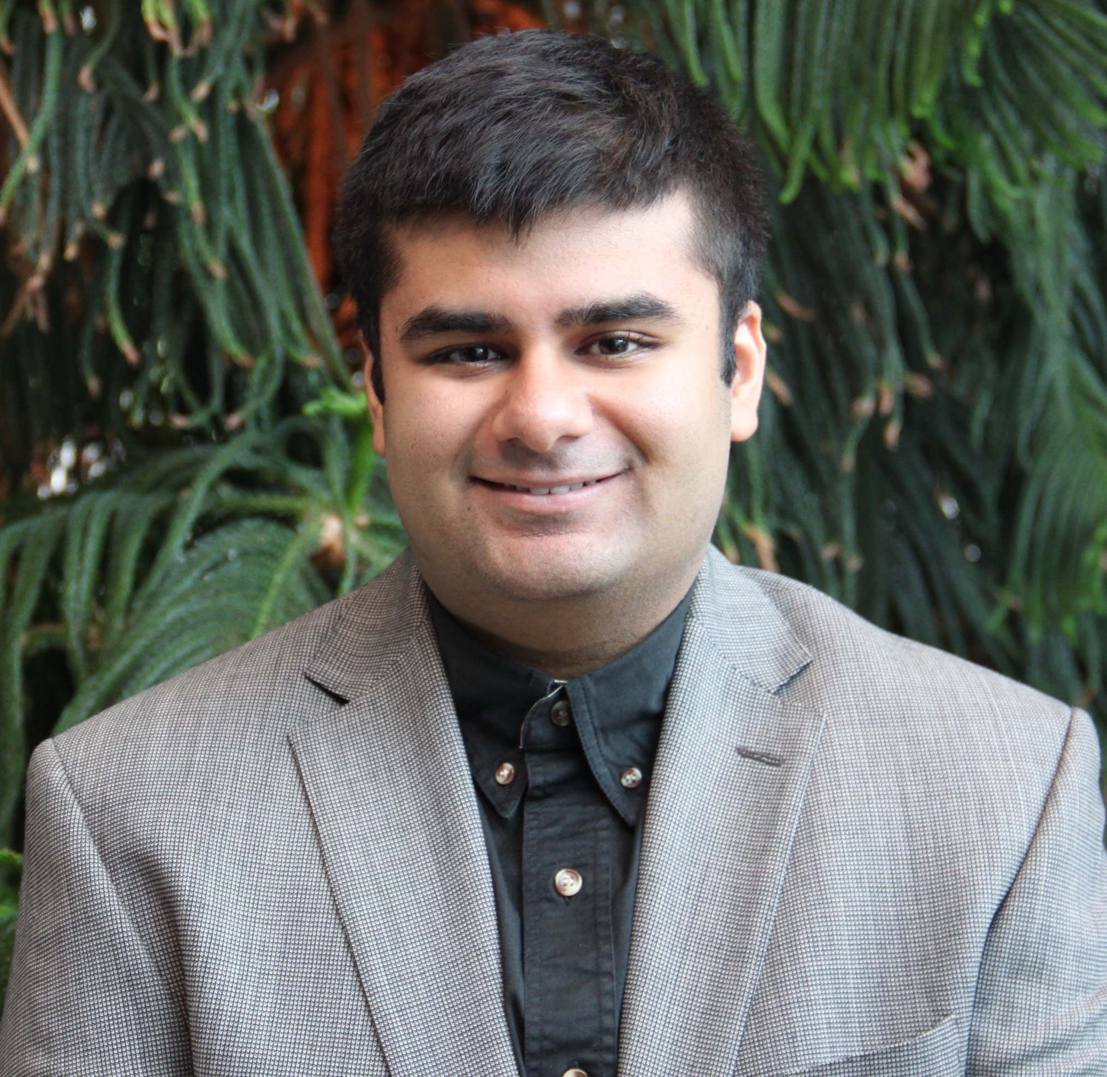
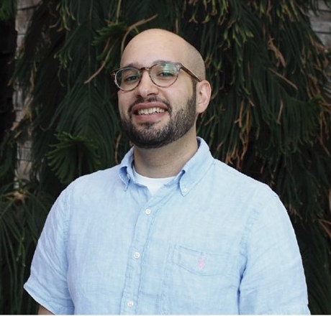
Teaching Assistants
Jalees Nasir
PhD student in the McArthur lab
BSc in Chemical Biology (McMaster)
Genomic surveillance of respiratory viruses
Shahrokh Shekarriz
PhD student in the Surettelab
BSc in Molecular Biology (University of Tehran)
MSc in x with Brian Golding (McMaster University)

Slide 4


Slide 5
Practical
Bioinformatics
Genomics

Slide 6
Practical
Bioinformatics
Biological Data | Computer Science | Math | Engineering | Statistics
Genomics

Slide 7
Practical
Bioinformatics
Biological Data | Computer Science | Math | Engineering | Statistics
Genomics
DNA | RNA | Sequencing Data | Genomes

Slide 8
Practical
Problem-Based Learning | Real Experimental Data | Hands-On
Bioinformatics
Biological Data | Computer Science | Math | Engineering | Statistics
Genomics
DNA | RNA | Sequencing Data | Genomes

Slide 9

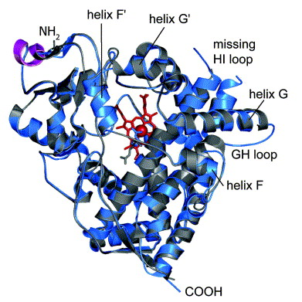

For Example…
Two weeks from now…
Annotation of the toxicological defensome of a Shark

Slide 10
For Example…
After reading break...
Process sequencing data using the command line

Slide 11
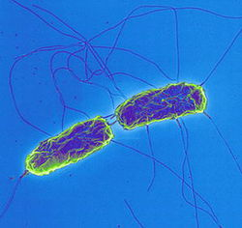
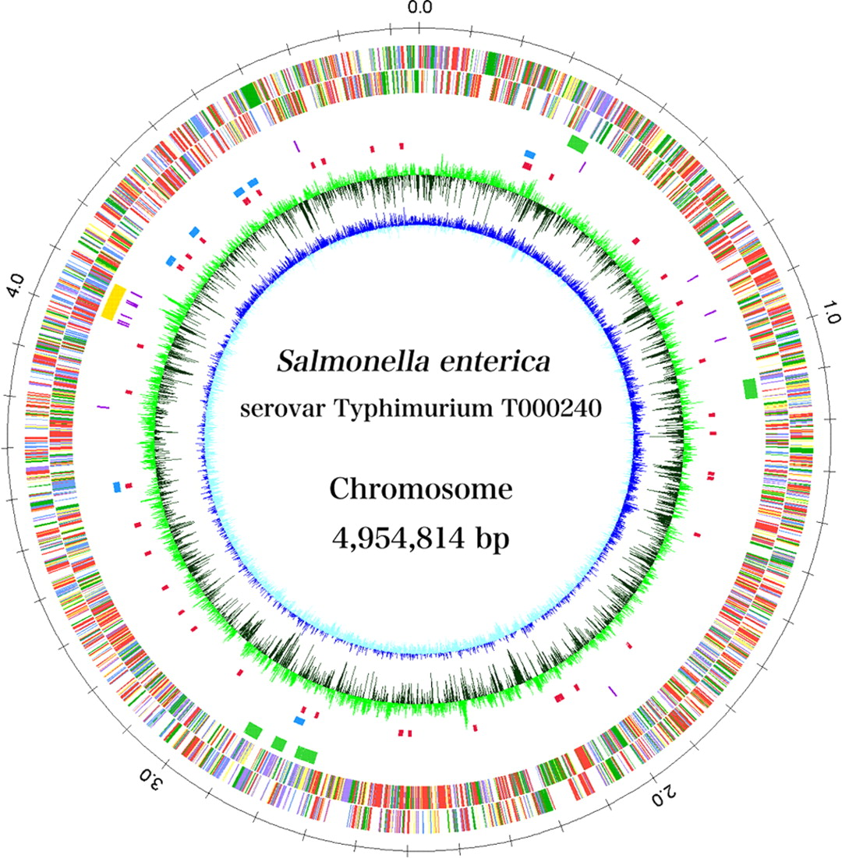
For Example…
Early November...
Use genomics to analyze a pathogen outbreak

Slide 12
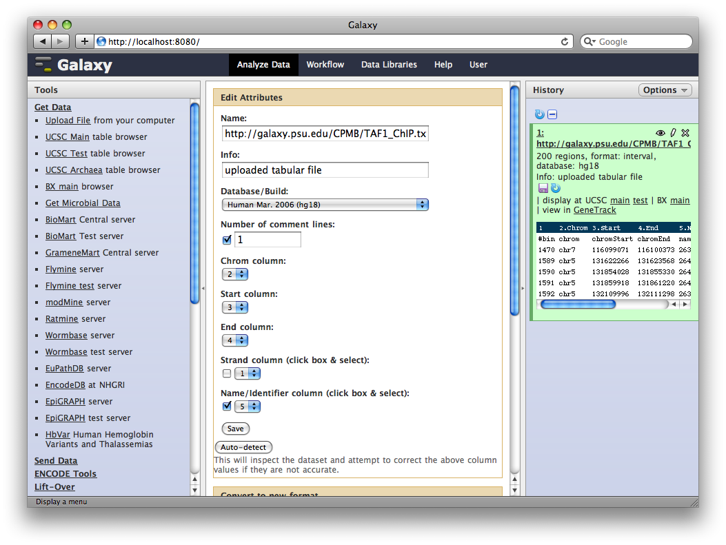
For Example…
By the end of November...
Use cloud computing to analyze gene expression data

Slide 13
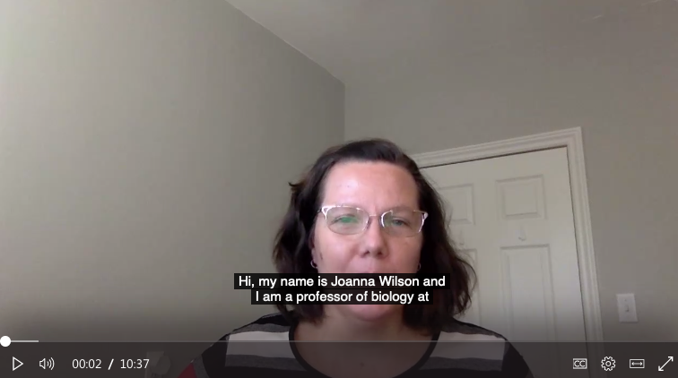
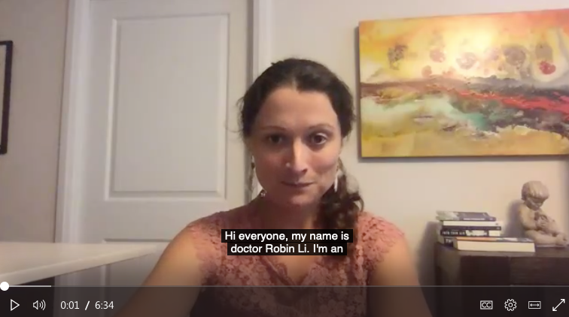
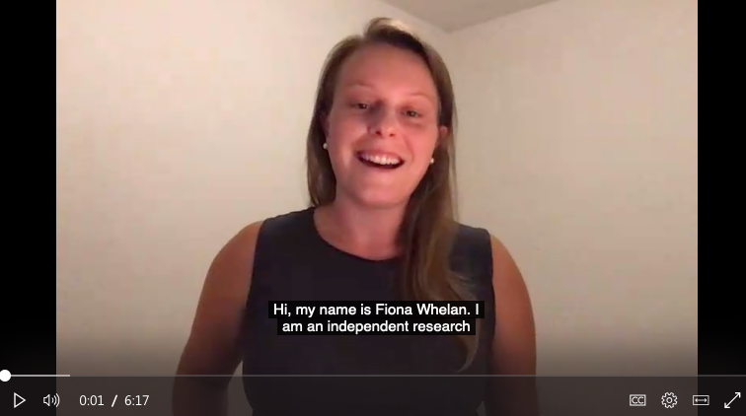
Online Learning…
Research highlights
7 hands on labs:
Genome databases
Phylogeny
Analysis of predicted proteins
Sequencing
Genome assembly
Gene expression analysis
Human Genetics Week
Pandemic Week
Analytics Guest Speakers

Slide 14

No Computer Science Experience Required
Registered students are from Biomedical Discovery & Commercialization, Biochemistry, iSci, Molecular Biology & Genetics, Medical & Biological Physics
The course goal is to teach you the theory and practice of analysis of real world research data in the biological / biomedical sciences.
The course will provide an introduction to Bioinformatics plus expand your research toolkit.

Slide 16
Course Structure
Electronic Resources
We will use Avenue to Learn for submitting assessments and grading
Tutorials: https://github.com/jstearns/Biochem-3BP3
Lecture PPT files will be added to GitHub and A2L
MS Teams for asynchronous communication and videoconferencing
Course Schedule & Resources – links to all videos!
Flash Update Presentation Schedule

Slide 17
Course Structure
Weekly Modules
Traditional lecture to introduce the topic and outline the key objectives
Lectures will be recorded in advance of each module
Teams Word document will provide links to lectures and supplementary presentations.
Please attend Wednesday 12:30 pm sessions for live updates
Live updates will be recorded for later access

Slide 18
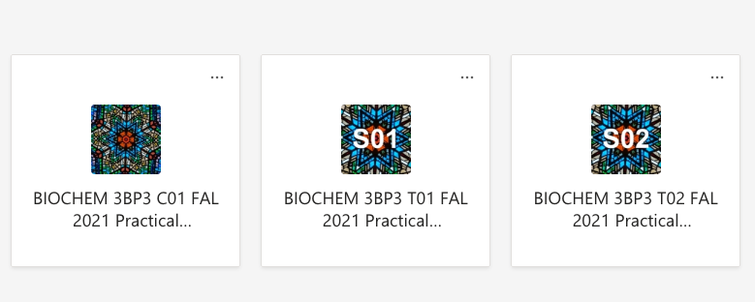
Course Structure – MS Teams

Slide 19
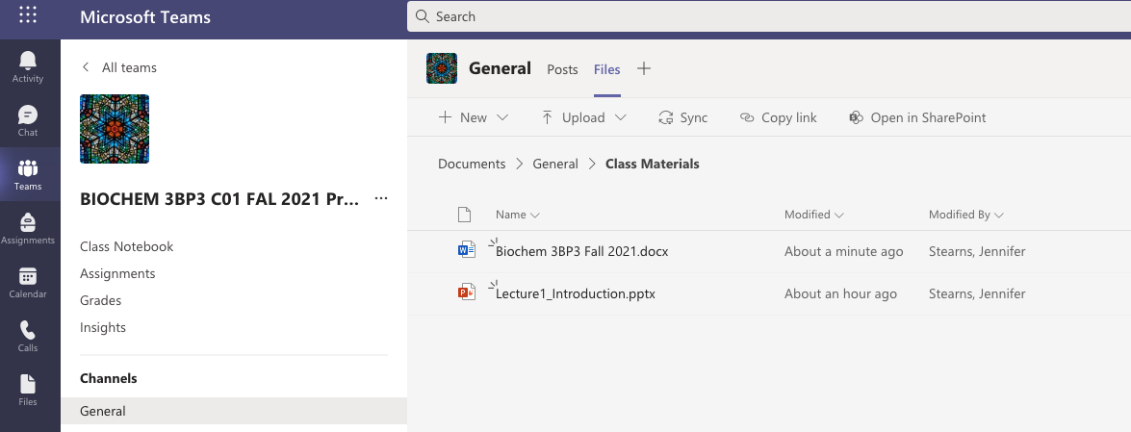
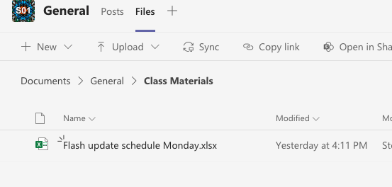
Course Structure – MS Teams

Slide 20
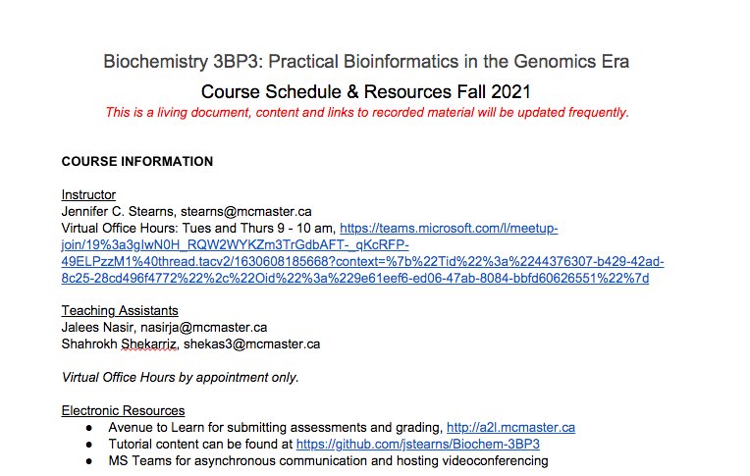
Course Structure – Files in Teams

Slide 21
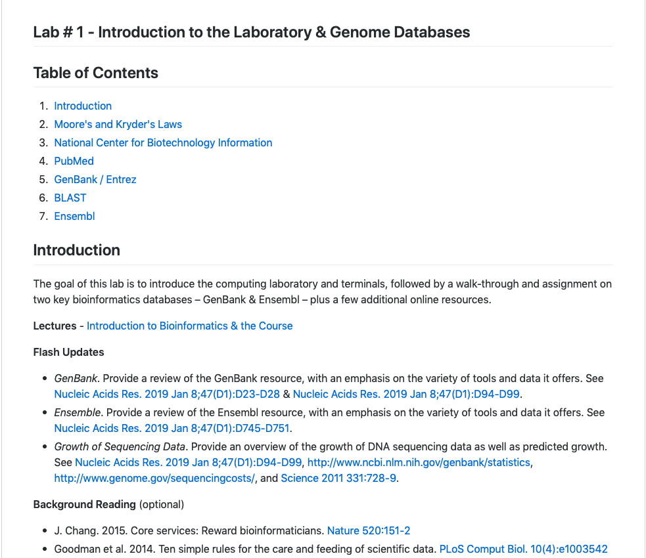
Course Structure - GitHub

Slide 22
Course Structure – A2L
Avenue to Learn
Documents needed to complete each tutorial
Assignments and marking rubrics
Presentation marking rubric
Quizzes

Slide 23
Course Structure
Weekly Modules – Tutorial sessions Mondays & Wednesdays
Tutorials will start LIVE at the tutorial session start time
3 students give a 10 minute “Flash Update” presentation each week beginning on Sept 20th
Live sessions will be recorded for later access
Tutorials: https://github.com/jstearns/Biochem-3BP3
Includes additional reading that is optional
A list of questions and problems that you will use to work through the tutorial
A core take-home assignment due on Avenue to Learn that will include:
Answers to tutorial problems
multiple choice questions on the lecture and the flash presentations

Slide 24
Flash Updates
See the Flash Update Presentation Schedule in Team files for each tutorial session
A Flash Update is a 10 minute PowerPoint presentation summarizing the key points of the assigned topic
Must include 3 https://kahoot.com questions!
PowerPoint file must be uploaded to Avenue to Learn by start of lab on Mondays & Wednesdays!

Slide 25
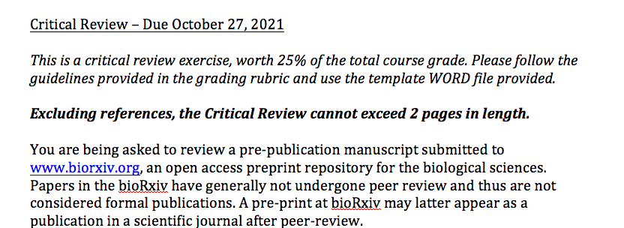
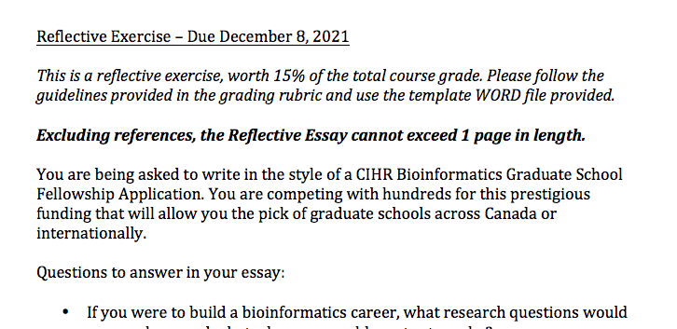
Essay Assignments

Slide 26
Grading
Course Outline & Marking Rubrics are on Avenue to Learn:
Item graded | % of final grade | Due date
Lab assignments (7) | 35% | weekly
10 min presentation | 15% | varies
Lecture quizzes (2) | 10% | varies
Critical review | 25% | October 27, 2021
Essay assignment | 15% | December 8, 2021
No textbook – primary literature only
TAs are available by appointment – see them first!
All work submitted via Avenue to Learn
Late penalty of 10% per day (grade of zero after 4 days)
Use McMaster Student Absence Form for absence less than 3 days
No exams!

Slide 27
A ‘Living’ Course
Each term – evolving lectures, data, tools
Problem-Based Learning, Inverted Teaching Style
Real Experimental Data
Not everything is going to go perfectly
Experimental data is messy – there may not be an “answer”
The schedule & tutorial details are tentative

Slide 28
Being Successful
Attend all live sessions, watch all recorded sessions
Ask questions and use your Teaching Assistant
Come to office hours or schedule a time to talk to me if things aren’t going well
“Take chances, make mistakes, get messy” – Miss Frizzle

Slide 29


A few things…
Avenue to Learn is central to the course – handing in assignments, schedules, Flash Update powerpoints, Lecture powerpoints, lab assignment downloads, etc.
All readings can be found on PubMed via a McMaster IP address or via the McMaster LibAccess portal if off campus: https://libraryssl.lib.mcmaster.ca (E-Journals)
Some aspects of the course will require use of McMaster’s Virtual Private Network: http://www.mcmaster.ca/uts/network/vpn/

Slide 30
Using PubMed

Slide 31
Using PubMed

Slide 32
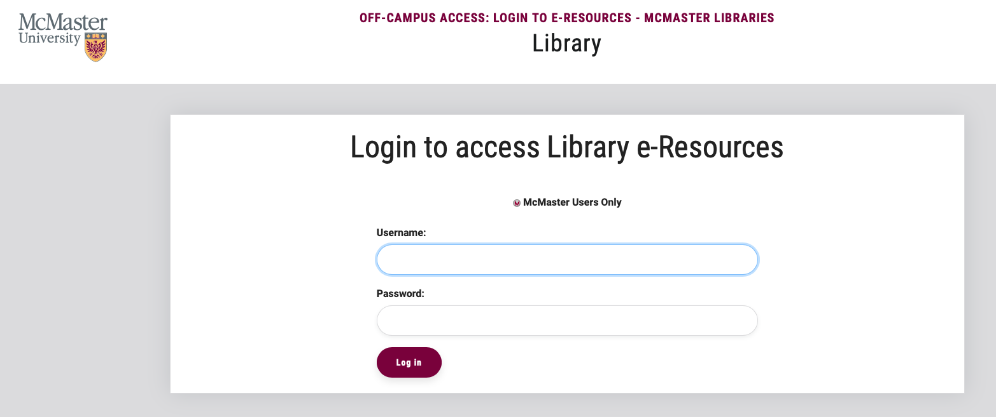
Using PubMed
https://libraryssl.lib.mcmaster.ca

Slide 33
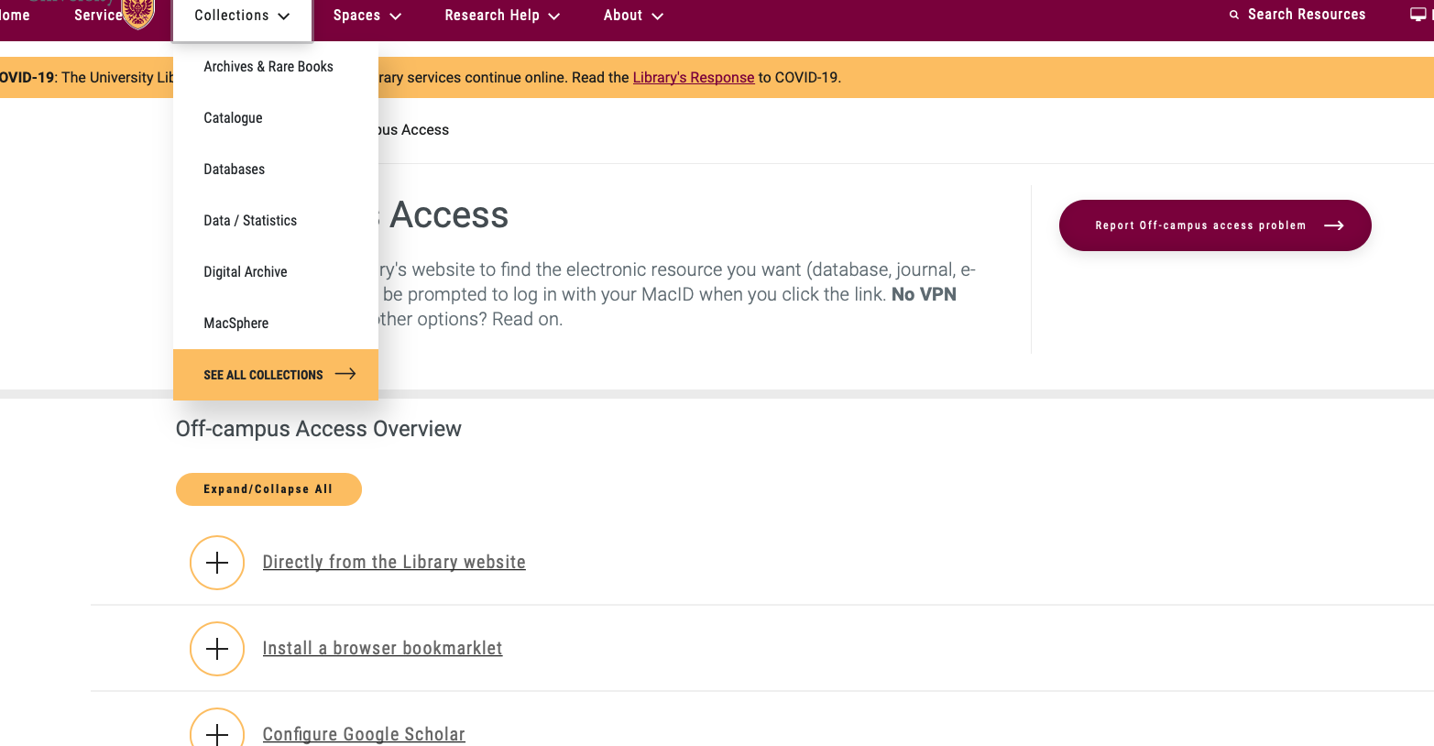
Using PubMed

Slide 34
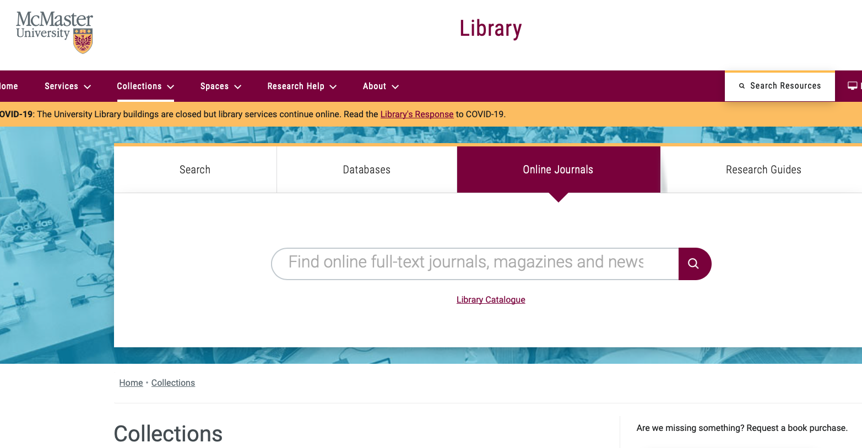
Using PubMed

Slide 35
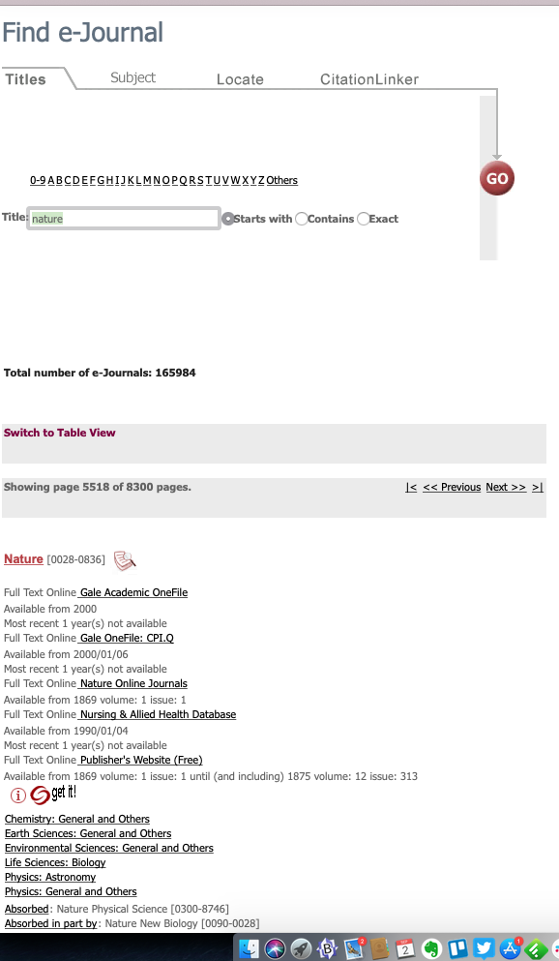
Using PubMed

Slide 36
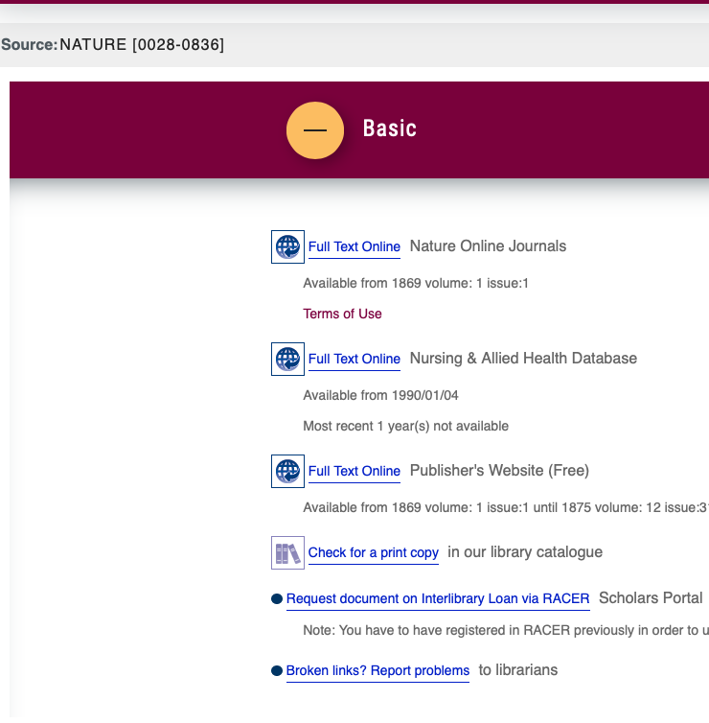
Using PubMed

Slide 37
Bioinformatics
Application of mathematical, statistical, and computational approaches to biological data
Modern emphasis (and emphasis of this course) is upon genomic data, dominated by DNA sequencing.
Yet, bioinformatics is very broad & diverse, for example:
chemoinformatics
protein structure, prediction of ligand binding
whole cell simulation
evolutionary biology
assay development
analytics and machine learning
J. Chang. 2015. Core services: Reward bioinformaticians. Nature 520:151-2.

Slide 38
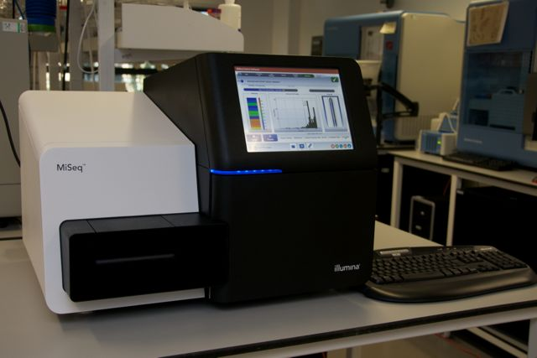
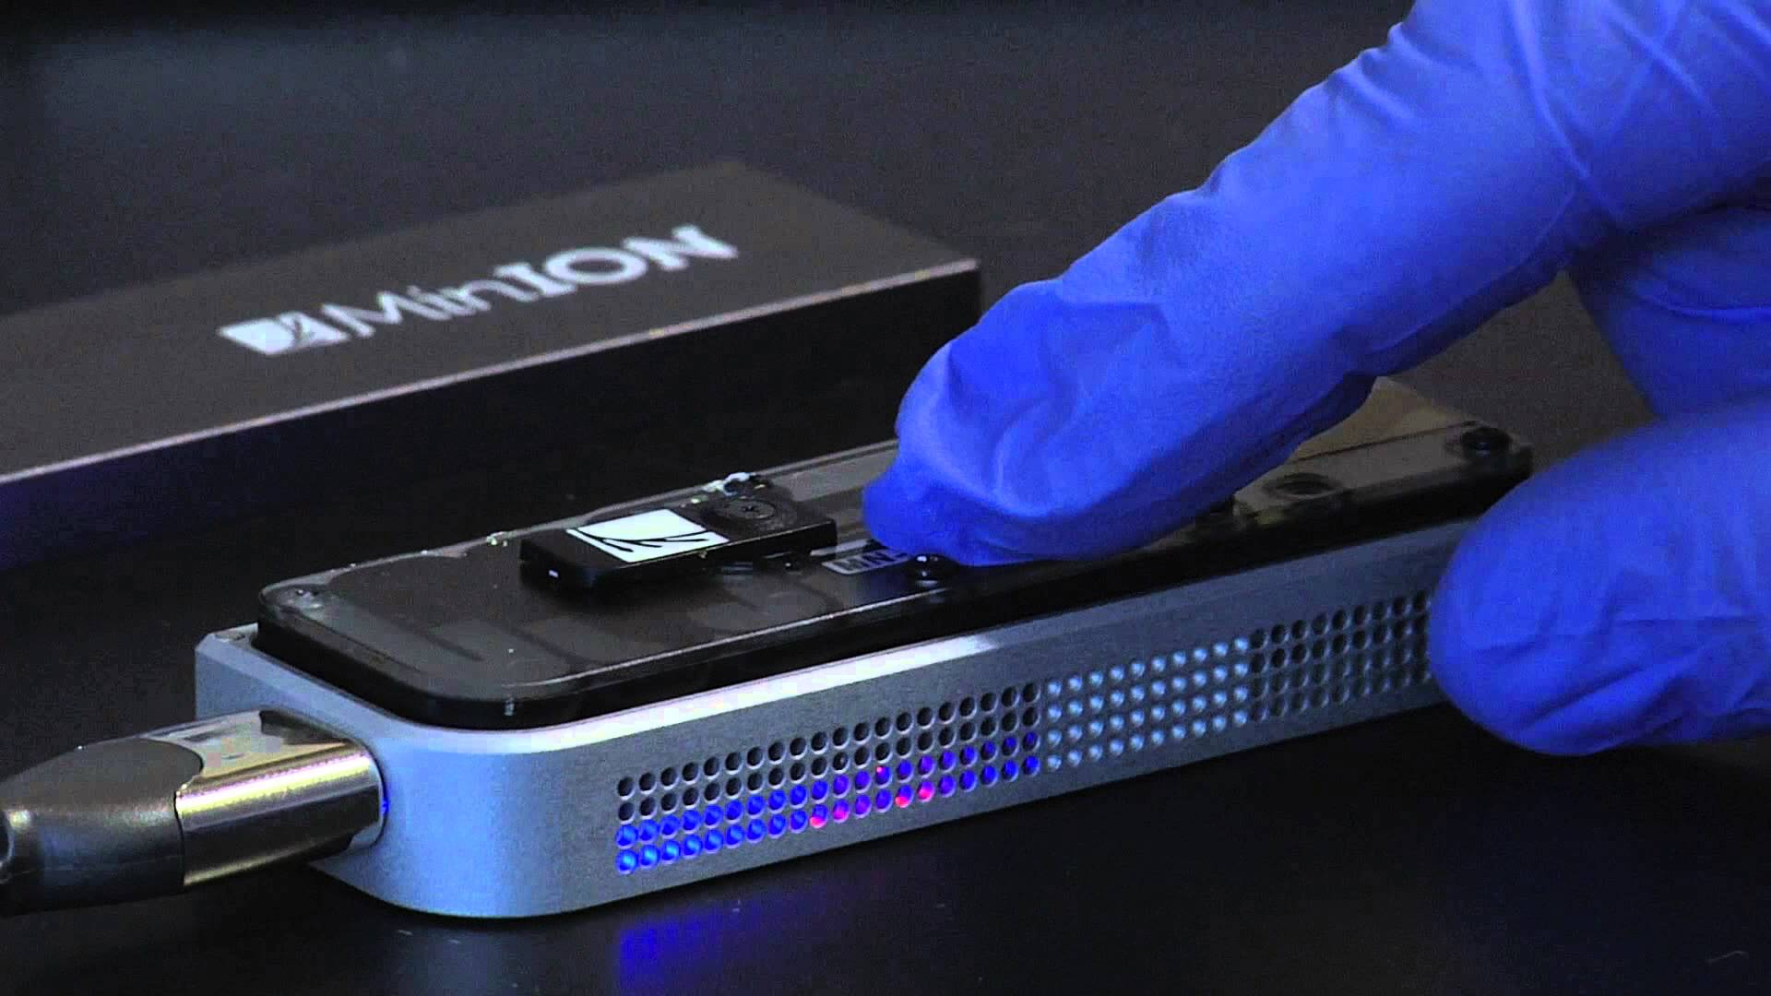
Bioinformatics
Even 10 years ago collecting low- to mid-volume data (e.g. DNA sequencing) was slow and expensive
Now – large scale data collection fast and inexpensive
DNA sequencing is quickly becoming an “assay” – performed by many researchers whose primary goal is not bioinformatics
We now need a balance between bioinformatics labs / core facilities and translating the skill set to researchers in all areas of bioscience
Illumina DNA Sequencer
Nanopore DNA Sequencer

Slide 39
Bioinformatics – Relative Costs
Sboner et al. 2011. The real cost of sequencing: higher than you think! Genome Biol. 12(8):125.
Next Generation Sequencing (NGS) – Low cost, high volume advanced sequencing methods, e.g. Solexa/Illumina massively parallel sequencing
Pre-NGS – High cost, low volume DNA sequencing based on the Sanger sequencing method

Slide 40
Bioinformatics
Bioinformatics can be…
Hypothesis testing using experimentally generated data
Data curation and knowledge integration
Data mining as part of experimental design
There are no ‘one size fits all’ analyses
“Pure” bioinformatics is rare – new algorithm or data schema development
Most bioinformatics is “applied” and highly collaborative
Bioinformaticians need to understand the biology and lab work

Slide 41
Bioinformatics
This course will survey a number of key applied bioinformatics questions, with an introduction to the underlying theory
The course emphasizes breadth instead of depth
Go deeper...
Bioinformatics 4th year thesis project
Co-Op in a Bioinformatics lab
Graduate school

Slide 42
Bioinformatics
Bioinformatics is one of the data sciences
data – actual measurements and observations
metadata – information on methods, observer ID, date time, etc.
software & algorithms
databases and data formats
computing hardware & networks

Slide 43
Bioinformatics
Publish and share your data or it might as well not exist!
Permanent identifiers are essential
Follow data and file format standards
Document and share your methods, software & workflows – this is important metadata
Love your data scientist – Biocurators are the underdogs of modern biological research

Slide 44
BioCuration & Databases
One of the most important tools in bioinformatics today is the database
Primary – raw data – DNA sequence, protein structure, chemical structure, gene expression measurements, etc
Secondary – integration of many sources of primary data, often organism-specific (e.g. Drosophila DB) or area specific (e.g. drug-drug interaction DB)
Literature curation (human or automated) and higher-level conceptual organization of knowledge (e.g. ontologies) increasingly important
Burge et al. 2012. Biocurators and biocuration: surveying the 21st century challenges. Database Mar 20:bar059

Slide 45
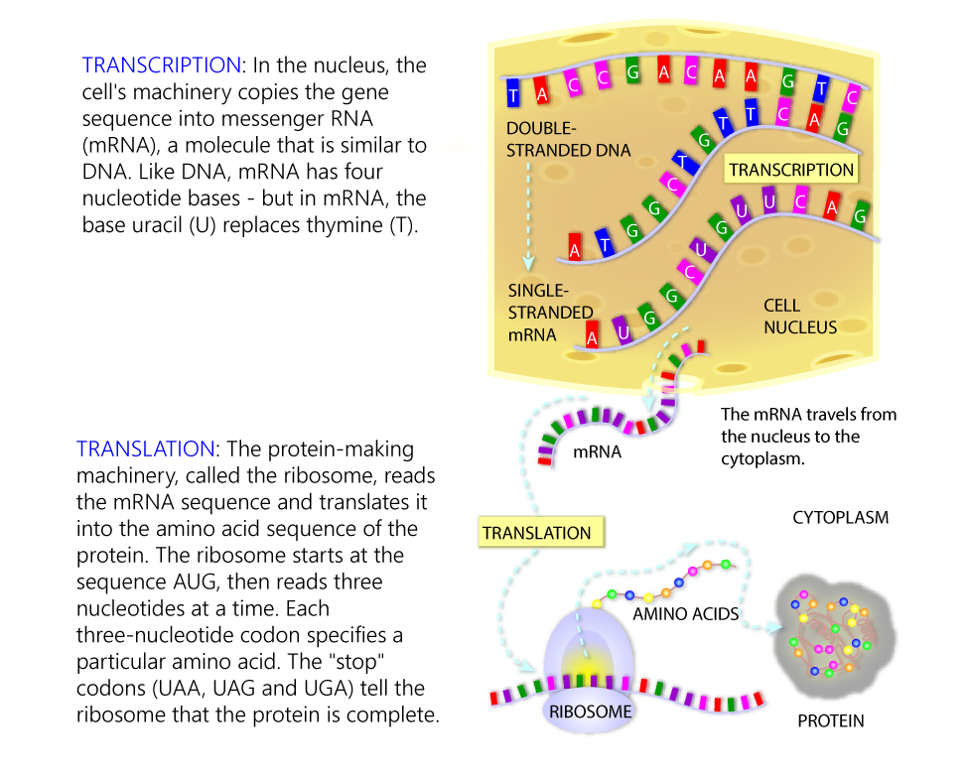
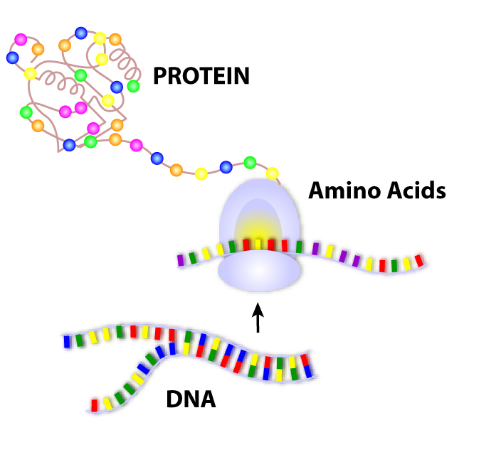
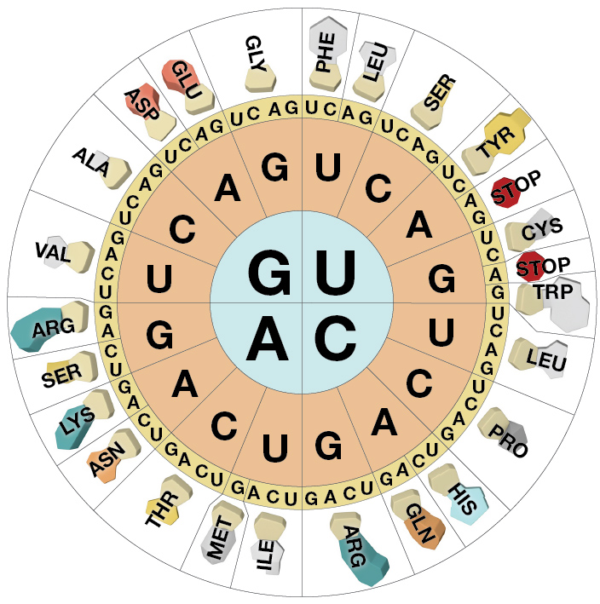
Next Week’s Lab focuses on Databases
Central Dogma
adenine and guanine are purines
cytosine, thymine, and uracil are pyrimidines
Images from "Genetic Science Learning Center, University of Utah, http://learn.genetics.utah.edu."

Slide 46
Next Week’s Lab focuses on Databases
Moore’s Law (computer processor speed doubles every 18 months) and Kryder’s Law (disk storage capacity doubles every 14 months) are critical to the future of biological research, see http://www.scientificamerican.com/article/kryders-law/
Will advances in DNA sequencing outstrip Moore’s and Kryder’s law?
Sboner et al. 2011. The real cost of sequencing: higher than you think! Genome Biol. 12(8):125.
NGS
Stein. 2010. The case for cloud computing in genome informatics. Genome Biol. 11(5):207.

